Slide 1

COMPUTER NETWORKS
Ashwini M Joshi.
Department of Computer Science and Engineering
ashwinimjoshi@pes.edu

Slide 2

COMPUTER NETWORKS
Unit – 4 Network Layer and Internet Protocol
  4.1 Overview of Network Layer
  4.2 What’s Inside a Router?
  4.3 Switching
  4.4 The Internet Protocol (IP)
    Datagram format
    Fragmentation
    IPv4 addressing
    NAT
  4.5 Introduction to Network Layer Protocols
    DHCP
    ICMP
  4.6 IPv6 Addressing
  4.7 Introduction to Routing Algorithms

Slide 3
COMPUTER NETWORKS
Unit – 4 Network Layer and Internet Protocol
  4.1 Overview of Network Layer
  4.2 What’s Inside a Router?
  4.3 Switching
  4.4 The Internet Protocol (IP)
    Datagram format
    Fragmentation
    IPv4 addressing
    NAT
  4.5 Introduction to Network Layer Protocols
    DHCP
    ICMP
  4.6 IPv6 Addressing
  4.7 Introduction to Routing Algorithms

Slide 4


















COMPUTER NETWORKS
Network-layer Services and Protocol
transport segment from sending to receiving host
  sender: encapsulates segments into datagrams, passes to link layer
  receiver: delivers segments to transport layer protocol
network layer protocols in every Internet device: hosts, routers
routers:
  examines header fields in all IP datagrams passing through it
  moves datagrams from input ports to output ports to transfer datagrams along end-end path
mobile network
national or global ISP
application
transport
network
link
physical
network
link
physical
network
link
physical
network
link
physical
network
link
physical
network
link
physical
datacenter
network
application
transport
network
link
physical
enterprise
network

Slide 5


COMPUTER NETWORKS
Two Key Network-layer Functions
network-layer functions:
forwarding: move packets from a router’s input link to appropriate router output link
analogy: taking a trip
forwarding: process of getting through single interchange
routing: process of planning trip from source to destination
routing: determine route taken by packets from source to destination
  routing algorithms
forwarding
routing

Slide 6
COMPUTER NETWORKS
Interplay between Routing and Forwarding
routing algorithm
routing algorithm determines
end-end-path through network
local forwarding table
forwarding table determines
local forwarding at this router
header value
output link
0100
0101
0111
1001
3
2
2
1
value in arriving
packet’s header
0111
1
3
2

Slide 7
COMPUTER NETWORKS
Connection Setup
3rd important function in some network architectures:
  ATM, frame relay, X.25
before datagrams flow, two end hosts and intervening routers establish virtual connection
  routers get involved
network vs transport layer connection service:
  network: between two hosts (may also involve intervening routers in case of VCs)
  transport: between two processes

Slide 8
COMPUTER NETWORKS
Network Service Model
Q: What service model for “channel” transporting datagrams from sender to receiver?
example services for individual datagrams:
guaranteed delivery
guaranteed delivery with less than 40 msec delay
example services for a flow of datagrams:
in-order datagram delivery
guaranteed minimum bandwidth to flow
restrictions on changes in inter-packet spacing

Slide 9
COMPUTER NETWORKS
Network-layer Service Model
Quality of Service (QoS) Guarantees?
Network
Architecture
Internet
ATM
ATM
Internet
Internet
Service
Model
best effort
Constant Bit Rate
Available Bit Rate
Intserv Guaranteed
(RFC 1633)
Diffserv (RFC 2475)
Bandwidth
none
Constant rate
Guaranteed min
yes
possible
Loss
no
yes
no
yes
possibly
Order
no
yes
yes
yes
possibly
Timing
no
yes
no
yes
no
Internet “best effort” service model
No guarantees on:
  successful datagram delivery to destination
  timing or order of delivery
  bandwidth available to end-end flow

Slide 10
COMPUTER NETWORKS
Network-layer Service Model
Quality of Service (QoS) Guarantees ?
Network
Architecture
Internet
ATM
ATM
Internet
Internet
Service
Model
best effort
Constant Bit Rate
Available Bit Rate
Intserv Guaranteed
(RFC 1633)
Diffserv (RFC 2475)
Bandwidth
none
Constant rate
Guaranteed min
yes
possible
Loss
no
yes
no
yes
possibly
Order
no
yes
yes
yes
possibly
Timing
no
yes
no
yes
no

Slide 11
COMPUTER NETWORKS
Unit – 4 Network Layer and Internet Protocol
  4.1 Overview of Network Layer
  4.2 What’s Inside a Router?
  4.3 Switching
  4.4 The Internet Protocol (IP)
    Datagram format
    Fragmentation
    IPv4 addressing
    NAT
  4.5 Introduction to Network Layer Protocols
    DHCP
    ICMP
  4.6 IPv6 Addressing
  4.7 Introduction to Routing Algorithms

Slide 12
COMPUTER NETWORKS
Router Architecture Overview
high-level view of generic router architecture:
routing, management
control plane (software)
operates in millisecond
time frame
routing
processor
forwarding data plane (hardware) operates in nanosecond timeframe
high-speed
switching
fabric
router input ports
router output ports

Slide 13
COMPUTER NETWORKS
Input port queuing
If switch fabric slower than input ports combined -> queueing may occur at input queues
  queueing delay and loss due to input buffer overflow!
Head-of-the-Line (HOL) blocking: queued datagram at front of queue prevents others in queue from moving forward
switch
fabric
switch
fabric
output port contention: only one red datagram can be transferred. lower red packet is blocked
one packet time later: green packet experiences HOL blocking

Slide 14

COMPUTER NETWORKS
Output port queuing
This is a really important slide
datagram
buffer
queueing
switch
fabric
(rate: NR)
link
layer
protocol
(send)
line
termination
R
Buffering required when datagrams arrive from fabric faster than link transmission rate. Drop policy: which datagrams to drop if no free buffers?
Datagrams can be lost due to congestion, lack of buffers
Priority scheduling – who gets best performance, network neutrality
Scheduling discipline chooses among queued datagrams for transmission

Slide 15
COMPUTER NETWORKS
Output port queuing
switch
fabric
switch
fabric
at t, packets more
from input to output
one packet time later
buffering when arrival rate via switch exceeds output line speed
queueing (delay) and loss due to output port buffer overflow!

Slide 16
COMPUTER NETWORKS
Buffer Management
buffer management:
drop: which packet to add, drop when buffers are full
  tail drop: drop arriving packet
  priority: drop/remove on priority basis
datagram
buffer
queueing
scheduling
switch
fabric
link
layer
protocol
(send)
line
termination
R
Abstraction: queue
marking: which packets to mark to signal congestion (ECN, RED)
R
packet
departures
packet
arrivals
queue
(waiting area)
link
(server)

Slide 17
COMPUTER NETWORKS
Unit – 4 Network Layer and Internet Protocol
  4.1 Overview of Network Layer
  4.2 What’s Inside a Router?
  4.3 Switching
  4.4 The Internet Protocol (IP)
    Datagram format
    Fragmentation
    IPv4 addressing
    NAT
  4.5 Introduction to Network Layer Protocols
    DHCP
    ICMP
  4.6 IPv6 Addressing
  4.7 Introduction to Routing Algorithms

Slide 18
COMPUTER NETWORKS
Network Layer: Internet
host, router network layer functions:
transport layer: TCP, UDP
IP protocol
datagram format
addressing
packet handling conventions
Path-selection algorithms: implemented in
routing protocols (OSPF, BGP)
SDN controller
network
layer
forwarding
table
ICMP protocol
error reporting
router “signaling”
link layer
physical layer

Slide 19
COMPUTER NETWORKS
IP Datagram Format
32 bits
IP protocol version number
head.
len
type of
service
total datagram
length (bytes)
ver
length
header length(bytes)
“type” of service:
diffserv (0:5)
ECN (6:7)
flgs
fragment
offset
fragmentation/
reassembly
16-bit identifier
time to
live
upper
layer
header
checksum
header checksum
TTL: remaining max hops
(decremented at each router)
source IP address
32-bit source IP address
destination IP address
Maximum length: 64K bytes
Typically: 1500 bytes or less
upper layer protocol (e.g., TCP or UDP)
32-bit destination IP address
overhead
options (if any)
e.g., timestamp, record route taken
20 bytes of TCP
20 bytes of IP
= 40 bytes + app layer overhead for TCP+IP
payload data
(variable length,
typically a TCP
or UDP segment)

Slide 20
COMPUTER NETWORKS
Unit – 4 Network Layer and Internet Protocol
  4.1 Overview of Network Layer
  4.2 What’s Inside a Router?
  4.3 Switching
  4.4 The Internet Protocol (IP)
    Datagram format
    Fragmentation
    IPv4 addressing
    NAT
  4.5 Introduction to Network Layer Protocols
    DHCP
    ICMP
  4.6 IPv6 Addressing
  4.7 Introduction to Routing Algorithms

Slide 21

COMPUTER NETWORKS
IP fragmentation, reassembly
network links have MTU (max.transfer size) - largest possible link-level frame
  different link types, different MTUs
large IP datagram divided (“fragmented”) within net
  one datagram becomes several datagrams
  “reassembled” only at final destination
  IP header bits used to identify, order related fragments
…
fragmentation:
in: one large datagram
out: 3 smaller datagrams
reassembly
…

Slide 22
COMPUTER NETWORKS
IP fragmentation, reassembly
length
=4000
ID
=x
fragflag
=0
offset
=0
example:
4000 byte datagram
MTU = 1500 bytes
one large datagram becomes
several smaller datagrams
1480 bytes in
data field
length
=1500
ID
=x
fragflag
=1
offset
=0
offset =
1480/8
length
=1500
ID
=x
fragflag
=1
offset
=185
length
=1040
ID
=x
fragflag
=0
offset
=370

Slide 23
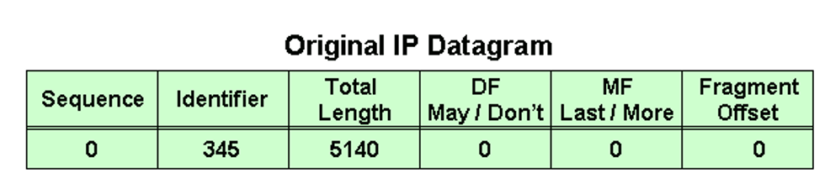
COMPUTER NETWORKS
Fragmentation – Example

Slide 24
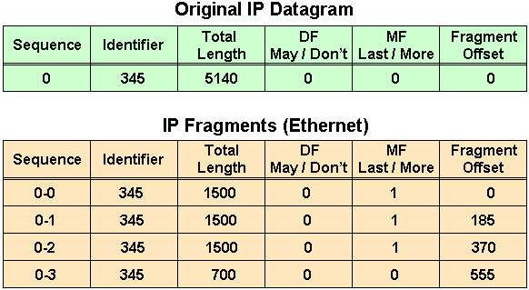
COMPUTER NETWORKS
Fragmentation – Example

Slide 25

COMPUTER NETWORKS
Fragmentation – Numerical Example
An IP router with a Maximum Transmission Unit (MTU) of 200 bytes has received an IP packet of size 520 bytes with an IP header of length 20 bytes. The values of the relevant fields in the IP header.

Slide 26
COMPUTER NETWORKS
Fragmentation – Numerical Example
An IP router with a Maximum Transmission Unit (MTU) of 200 bytes has received an IP packet of size 520 bytes with an IP header of length 20 bytes. The values of the relevant fields in the IP header.

Slide 27
COMPUTER NETWORKS
Unit – 4 Network Layer and Internet Protocol
  4.1 Overview of Network Layer
  4.2 What’s Inside a Router?
  4.3 Switching
  4.4 The Internet Protocol (IP)
    Datagram format
    Fragmentation
    IPv4 addressing
    NAT
  4.5 Introduction to Network Layer Protocols
    DHCP
    ICMP
  4.6 IPv6 Addressing
  4.7 Introduction to Routing Algorithms

Slide 29
COMPUTER NETWORKS
IP addressing: Introduction
223.1.1.1
IP address: 32-bit unique ID associated with each host or router interface
interface: connection between host/router and physical link
  router’s typically have multiple interfaces
  host typically has one or two interfaces (e.g., wired Ethernet, wireless 802.11)
223.1.2.1
223.1.1.2
223.1.1.4
223.1.2.9
223.1.1.3
223.1.3.27
223.1.2.2
223.1.3.1
223.1.3.2
dotted-decimal IP address notation:
223.1.1.1 = 11011111 00000001 00000001 00000001
223
1
1
1

Slide 30
COMPUTER NETWORKS
IP addressing: Introduction
Change the following IPv4 addresses from binary notation to dotted-decimal notation.
Solution:
We replace each group of 8 bits with its equivalent decimal number and add dots for separation.

Slide 31
COMPUTER NETWORKS
IP addressing: Introduction
Change the following IPv4 addresses from dotted-decimal notation to binary notation.
Solution:
We replace each decimal number with its binary equivalent.

Slide 32
COMPUTER NETWORKS
IP addressing: Introduction
223.1.1.1
Q: how are interfaces actually connected?
223.1.2.1
223.1.1.2
A: we’ll learn about that in chapters 6, 7
A: wired
Ethernet interfaces connected by Ethernet switches
223.1.1.4
223.1.2.9
223.1.1.3
223.1.3.27
223.1.2.2
For now: don’t need to worry about how one interface is connected to another (with no intervening router)
223.1.3.1
223.1.3.2
A: wireless WiFi interfaces connected by WiFi base station

Slide 33
COMPUTER NETWORKS
Subnets
What’s a subnet ?
  device interfaces that can physically reach each other without passing through an intervening router
223.1.1.1
223.1.2.1
223.1.1.2
223.1.1.4
223.1.2.9
223.1.1.3
223.1.3.27
223.1.2.2
IP addresses have structure:
  subnet part: devices in same subnet have common high order bits
  host part: remaining low order bits
223.1.3.1
223.1.3.2
network consisting of 3 subnets
A portion of a network that shares a particular subnet address.

Slide 34
COMPUTER NETWORKS
Subnets
subnet 223.1.1.0/24
Recipe for defining subnets:
detach each interface from its host or router, creating “islands” of isolated networks
each isolated network is called a subnet
223.1.1.1
subnet 223.1.2.0/24
223.1.2.1
223.1.1.2
223.1.1.4
223.1.2.9
223.1.1.3
223.1.3.27
223.1.2.2
subnet
223.1.3.0/24
223.1.3.1
223.1.3.2
subnet mask: /24
(high-order 24 bits: subnet part of IP address)

Slide 35
COMPUTER NETWORKS
Subnets
223.1.1.2
subnet 223.1.1/24
where are the subnets?
what are the /24 subnet addresses?
223.1.1.1
223.1.1.4
223.1.1.3
223.1.9.2
223.1.7.0
subnet 223.1.7/24
subnet 223.1.9/24
223.1.9.1
223.1.7.1
223.1.8.1
223.1.8.0
subnet 223.1.2/24
223.1.2.6
subnet 223.1.8/24
223.1.3.27
A 32-bit combination used to describe which portion of an address refers to the subnet and which part refers to the host.
subnet 223.1.3/24
223.1.2.1
223.1.2.2
223.1.3.1
223.1.3.2

Slide 36
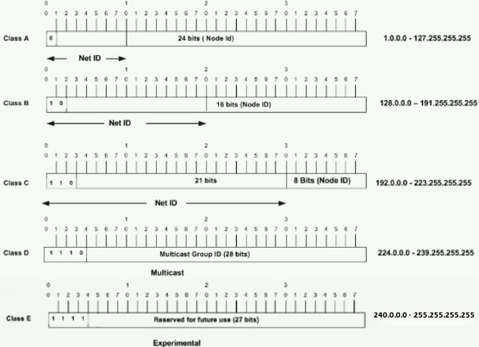
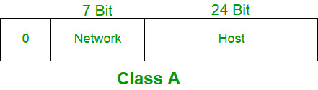
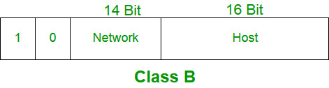
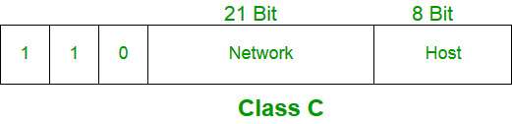
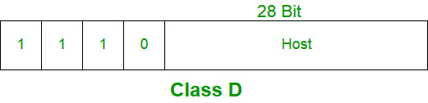
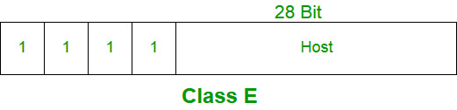
COMPUTER NETWORKS
IP addressing: Classful Addressing

Slide 37
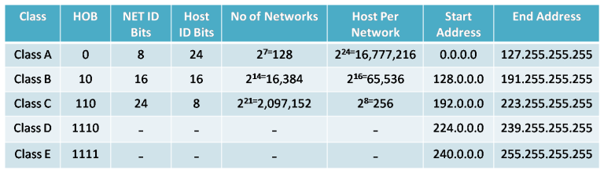
COMPUTER NETWORKS
IP addressing: Classful Addressing
Class D: multicast, Class E: reserved (experimental)
Network Masks
Class A: 255.0.0.0
Class B: 255.255.0.0
Class C: 255.255.255.0
Broadcast Address: 255.255.255.255

Slide 38
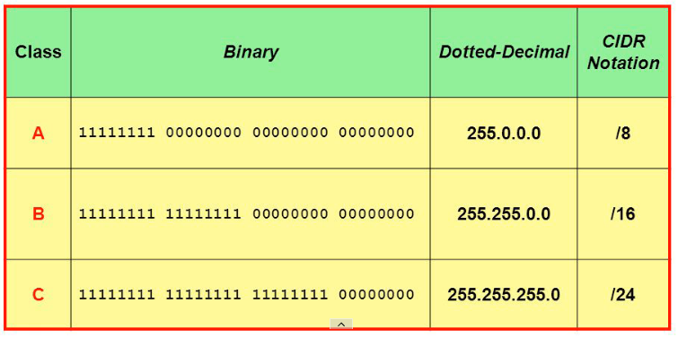
COMPUTER NETWORKS
IP addressing: Classful Subnet Masks

Slide 39
COMPUTER NETWORKS
IP addressing: introduction
Find the class of each address.
a. 00000001 00001011 00001011 11101111
b. 11000001 10000011 00011011 11111111
c. 14.23.120.8
d. 252.5.15.111
Solution
a. The first bit is 0. This is a class A address.
b. The first 2 bits are 1; the third bit is 0. This is a class C address.
c. The first byte is 14; the class is A.
d. The first byte is 252; the class is E.

Slide 40

COMPUTER NETWORKS
IP addressing: Why not Classful Addressing?
Network portion - 8, 16, or 24 bits in length – known as Class A, B and C networks respectively
A class C (/24) - accommodate only up to 2⁸ - 2 = 254 hosts (two of the 2⁸ = 256 addresses are reserved for special use)
A class B (/16) subnet, supports up to 65,634 hosts
A class A (/8) subnet, up to 16,777,214 hosts
too small for many organizations
too large, poor utilization
Classful addressing, which is almost obsolete, is replaced with classless addressing.

Slide 41
COMPUTER NETWORKS
IP addressing: CIDR
CIDR: Classless InterDomain Routing (pronounced “cider”)
  subnet portion of address of arbitrary length
  address format: a.b.c.d/x, where x is # bits in subnet portion of address
subnet
part
host
part
11001000 00010111 00010000 00000000
200.23.16.0/23

Slide 42
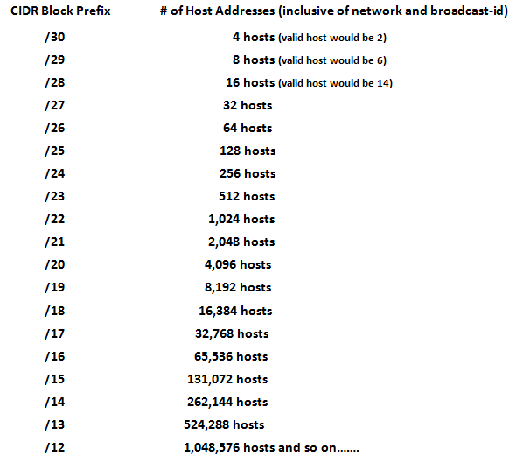
COMPUTER NETWORKS
IP addressing: CIDR

Slide 43
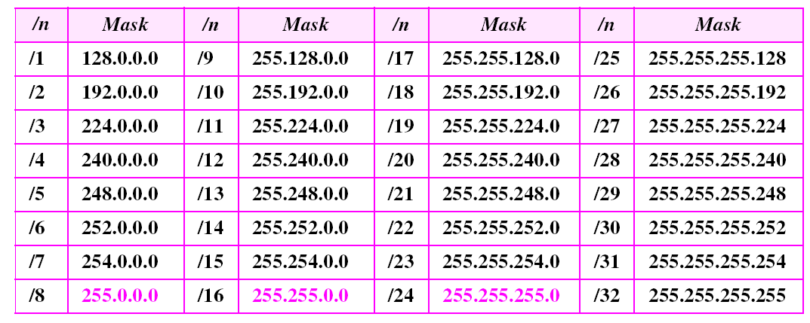
COMPUTER NETWORKS
IP addressing: CIDR – Prefix Lengths
The addresses in color are the default masks for classes A, B, and C.
Thus, classful addressing is a special case of classless addressing.

Slide 44
COMPUTER NETWORKS
IP addresses: how to get one?
Q: how does network get subnet part of IP address?
A: gets allocated portion of its provider ISP’s address space
ISP's block 11001000 00010111 00010000 00000000 200.23.16.0/20
ISP can then allocate out its address space in 8 blocks:
Organization 0 11001000 00010111 00010000 00000000 200.23.16.0/23
Organization 1 11001000 00010111 00010010 00000000 200.23.18.0/23
Organization 2 11001000 00010111 00010100 00000000 200.23.20.0/23
... ….. …. ….
Organization 7 11001000 00010111 00011110 00000000 200.23.30.0/23

Slide 45
IP address of one host is 25.34.12.56/16
Find the first addresses in this block.
Find the last addresses in this block.

Slide 46
IP address of one host is 182.44.82.16/26
Find the first addresses in this block.
Find the last addresses in this block.

Slide 47
An organization is granted the block 214.17.160.0/24. The administrator wants to create 8 subnets.
Find the subnet mask.
Find the last addresses in first subnet.
Find the first addresses in last subnet.

Slide 48
COMPUTER NETWORKS
Hierarchical addressing: route aggregation
hierarchical addressing allows efficient advertisement of routing information:
Organization 0
200.23.16.0/23
Organization 1
200.23.18.0/23
“Send me anything
with addresses
beginning
200.23.16.0/20”
The ability to use a single prefix to advertise multiple networks is often referred to as address aggregation (also route aggregation or route summarization).
Organization 2
200.23.20.0/23
.
Fly-By-Night-ISP
.
.
.
.
Internet
Organization 7
.
200.23.30.0/23
ISPs-R-Us
“Send me anything
with addresses
beginning
199.31.0.0/16”

Slide 49
COMPUTER NETWORKS
Hierarchical addressing: more specific routes
Organization 1 moves from Fly-By-Night-ISP to ISPs-R-Us
ISPs-R-Us now advertises a more specific route to Organization 1
Organization 0
200.23.16.0/23
Organization 1
200.23.18.0/23
“Send me anything
with addresses
beginning
200.23.16.0/20”
Organization 2
200.23.20.0/23
.
Fly-By-Night-ISP
.
.
.
.
Internet
Organization 7
.
200.23.30.0/23
ISPs-R-Us
“Send me anything
with addresses
beginning
199.31.0.0/16”
Organization 1
200.23.18.0/23
“or 200.23.18.0/23”

Slide 50
COMPUTER NETWORKS
Hierarchical addressing: more specific routes
Organization 1 moves from Fly-By-Night-ISP to ISPs-R-Us
ISPs-R-Us now advertises a more specific route to Organization 1
Organization 0
200.23.16.0/23
“Send me anything
with addresses
beginning
200.23.16.0/20”
Organization 2
200.23.20.0/23
.
Fly-By-Night-ISP
.
.
.
.
Internet
Organization 7
.
200.23.30.0/23
ISPs-R-Us
“Send me anything
with addresses
beginning
199.31.0.0/16”
Organization 1
200.23.18.0/23
“or 200.23.18.0/23”

Slide 51
COMPUTER NETWORKS
IP addresses: how to get one?
That’s actually two questions:
Q: How does a host get IP address within its network (host part of address)?
Q: How does a network get IP address for itself (network part of address)
How does host get IP address?
hard-coded by sysadmin in config file (e.g., /etc/rc.config in UNIX)
DHCP: Dynamic Host Configuration Protocol: dynamically get address from as server
  “plug-and-play”

Slide 52
COMPUTER NETWORKS
Unit – 4 Network Layer and Internet Protocol
  4.1 Overview of Network Layer
  4.2 What’s Inside a Router?
  4.3 Switching
  4.4 The Internet Protocol (IP)
    Datagram format
    Fragmentation
    IPv4 addressing
    NAT
  4.5 Introduction to Network Layer Protocols
    DHCP
    ICMP
  4.6 IPv6 Addressing
  4.7 Introduction to Routing Algorithms

Slide 53
COMPUTER NETWORKS
DHCP: Dynamic Host Configuration Protocol
goal: host dynamically obtains IP address from network server when it “joins” network
  can renew its lease on address in use
  allows reuse of addresses (only hold address while connected/on)
  support for mobile users who join/leave network
DHCP overview:
  host broadcasts DHCP discover msg [optional]
  DHCP server responds with DHCP offer msg [optional]
  host requests IP address: DHCP request msg
  DHCP server sends address: DHCP ack msg

Slide 54
COMPUTER NETWORKS
DHCP client-server scenario
Typically, DHCP server will be co-located in router, serving all subnets to which router is attached
DHCP server
223.1.1.1
223.1.2.1
223.1.2.5
223.1.1.2
223.1.1.4
223.1.2.9
223.1.1.3
223.1.3.27
arriving DHCP client needs
address in this network
223.1.2.2
223.1.3.1
223.1.3.2

Slide 55


COMPUTER NETWORKS
DHCP client-server scenario
DHCP server: 223.1.2.5
DHCP discover
Arriving client
src : 0.0.0.0, 68
dest.: 255.255.255.255,67
yiaddr: 0.0.0.0
transaction ID: 654
Broadcast: is there a DHCP server out there?
DHCP offer
src: 223.1.2.5, 67
dest: 255.255.255.255, 68
yiaddrr: 223.1.2.4
transaction ID: 654
lifetime: 3600 secs
Broadcast: I’m a DHCP server! Here’s an IP address you can use
The two steps above can be skipped “if a client remembers and wishes to reuse a previously allocated network address” [RFC 2131]
DHCP request
src: 0.0.0.0, 68
dest:: 255.255.255.255, 67
yiaddrr: 223.1.2.4
transaction ID: 655
lifetime: 3600 secs
Broadcast: OK. I would like to use this IP address!
DHCP ACK
src: 223.1.2.5, 67
dest: 255.255.255.255, 68
yiaddrr: 223.1.2.4
transaction ID: 655
lifetime: 3600 secs
Broadcast: OK. You’ve got that IP address!

Slide 56
COMPUTER NETWORKS
DHCP: more than IP addresses
DHCP can return more than just allocated IP address on subnet:
  address of first-hop router for client
  name and IP address of DNS sever
  network mask (indicating network versus host portion of address)

Slide 57


COMPUTER NETWORKS
DHCP: example
DHCP
DHCP
UDP
IP
Eth
Phy
Connecting laptop will use DHCP to get IP address, address of first-hop router, address of DNS server.
DHCP
DHCP
DHCP
DHCP
DHCP REQUEST message encapsulated in UDP, encapsulated in IP, encapsulated in Ethernet
DHCP
DHCP
UDP
IP
Eth
Phy
168.1.1.1
DHCP
DHCP
DHCP
Ethernet frame broadcast (dest: FFFFFFFFFFFF) on LAN, received at router running DHCP server
DHCP
router with DHCP
server built into
router
Ethernet demux’ed to IP demux’ed, UDP demux’ed to DHCP

Slide 58
COMPUTER NETWORKS
DHCP: example
DHCP
UDP
IP
Eth
Phy
DCP server formulates DHCP ACK containing client’s IP address, IP address of first-hop router for client, name & IP address of DNS server
DHCP
DHCP
DHCP
DHCP
encapsulated DHCP server reply forwarded to client, demuxing up to DHCP at client
DHCP
DHCP
UDP
IP
Eth
Phy
DHCP
DHCP
DHCP
router with DHCP
server built into
router
client now knows its IP address, name and IP address of DNS server, IP address of its first-hop router
DHCP

Slide 59
COMPUTER NETWORKS
IP addressing: last words…
Q: how does an ISP get block of addresses?
A: ICANN: Internet Corporation for Assigned Names and Numbers http://www.icann.org/
  allocates IP addresses, through 5 regional registries (RRs) (who may then allocate to local registries)
  manages DNS root zone, including delegation of individual TLD (.com, .edu, …) management
Q: are there enough 32-bit IP addresses?
ICANN allocated last chunk of IPv4 addresses to RRs in 2011
NAT (next) helps IPv4 address space exhaustion
IPv6 has 128-bit address space
"Who the hell knew how much address space we needed?" Vint Cerf (reflecting on decision to make IPv4 address 32 bits long)

Slide 60
COMPUTER NETWORKS
Unit – 4 Network Layer and Internet Protocol
  4.1 Overview of Network Layer
  4.2 What’s Inside a Router?
  4.3 Switching
  4.4 The Internet Protocol (IP)
    Datagram format
    Fragmentation
    IPv4 addressing
    NAT
  4.5 Introduction to Network Layer Protocols
    DHCP
    ICMP
  4.6 IPv6 Addressing
  4.7 Introduction to Routing Algorithms

Slide 61
COMPUTER NETWORKS
NAT: Network Address Translation
NAT: all devices in local network share just one IPv4 address as far as outside world is concerned
rest of
Internet
local network (e.g., home network) 10.0.0/24
10.0.0.1
138.76.29.7
10.0.0.4
10.0.0.2
10.0.0.3
all datagrams leaving local network have same source NAT IP address: 138.76.29.7, but different source port numbers
datagrams with source or destination in this network have 10.0.0/24 address for source, destination (as usual)

Slide 62
COMPUTER NETWORKS
NAT: Network Address Translation
  all devices in local network have 32-bit addresses in a “private” IP address space (10/8, 172.16/12, 192.168/16 prefixes) that can only be used in local network
  advantages:
    just one IP address needed from provider ISP for all devices
    can change addresses of host in local network without notifying outside world
    can change ISP without changing addresses of devices in local network
    security: devices inside local net not directly addressable, visible by outside world

Slide 63
COMPUTER NETWORKS
NAT: Network Address Translation
implementation: NAT router must (transparently):
  outgoing datagrams: replace (source IP address, port #) of every outgoing datagram to (NAT IP address, new port #)
      remote clients/servers will respond using (NAT IP address, new port #) as destination address
  remember (in NAT translation table) every (source IP address, port #) to (NAT IP address, new port #) translation pair
  incoming datagrams: replace (NAT IP address, new port #) in destination fields of every incoming datagram with corresponding (source IP address, port #) stored in NAT table

Slide 64
COMPUTER NETWORKS
NAT: Network Address Translation
NAT translation table
WAN side addr LAN side addr
2: NAT router changes datagram source address from 10.0.0.1, 3345 to 138.76.29.7, 5001,
updates table
1: host 10.0.0.1 sends datagram to 128.119.40.186, 80
138.76.29.7, 5001 10.0.0.1, 3345
…… ……
S: 10.0.0.1, 3345
D: 128.119.40.186, 80
10.0.0.1
1
2
S: 138.76.29.7, 5001
D: 128.119.40.186, 80
10.0.0.4
10.0.0.2
138.76.29.7
S: 128.119.40.186, 80
D: 10.0.0.1, 3345
4
S: 128.119.40.186, 80
D: 138.76.29.7, 5001
3
10.0.0.3
3: reply arrives, destination address: 138.76.29.7, 5001

Slide 65
COMPUTER NETWORKS
NAT: Network Address Translation
NAT has been controversial:
  routers “should” only process up to layer 3
  address “shortage” should be solved by IPv6
  violates end-to-end argument (port # manipulation by network-layer device)
  NAT traversal: what if client wants to connect to server behind NAT?
but NAT is here to stay:
  extensively used in home and institutional nets, 4G/5G cellular nets

Slide 66
COMPUTER NETWORKS
NAT: Network Address Translation
10.0.0.1
client
Solution: statically configure NAT to forward incoming connection requests at given port to server
  e.g., (123.76.29.7, port 25000) always forwarded to 10.0.0.1 port 25000
?
10.0.0.4
138.76.29.7
NAT
router

Slide 67
COMPUTER NETWORKS
Unit – 4 Network Layer and Internet Protocol
  4.1 Overview of Network Layer
  4.2 What’s Inside a Router?
  4.3 Switching
  4.4 The Internet Protocol (IP)
    Datagram format
    Fragmentation
    IPv4 addressing
    NAT
  4.5 Introduction to Network Layer Protocols
    DHCP
    ICMP
  4.6 IPv6 Addressing
  4.7 IPv6 Protocol
  4.8 Introduction to Routing Algorithms

Slide 68
COMPUTER NETWORKS
ICMP: Internet Control Message Protocol
Used by hosts and routers to communicate network-layer information.
Typical use of ICMP is for error reporting.
Eg: “Destination network unreachable”
ICMP messages – carried as IP payloads.
ICMP is often considered part of IP, but architecturally it lies just above IP.
ICMP messages have a type and a code field.
Type Code description
0 0 echo reply (ping)
3 0 dest. network unreachable
3 1 dest host unreachable
3 2 dest protocol unreachable
3 3 dest port unreachable
3 6 dest network unknown
3 7 dest host unknown
4 0 source quench (congestion control - not used)
8 0 echo request (ping)
9 0 route advertisement
10 0 router discovery
11 0 TTL expired
12 0 bad IP header

Slide 69
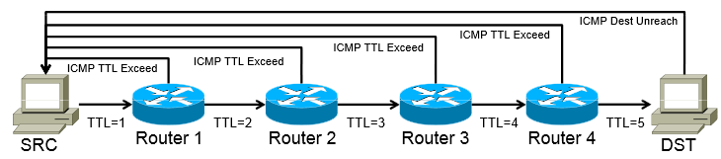
COMPUTER NETWORKS
ICMP: Internet Control Message Protocol
Perform – Network diagnostics
Utilities traceroute and ping – use ICMP.
Other examples of ICMP messages:
  Source quench message (congestion)
  Parameter problem (bad IP header)
  Time exceeded message (TTL)
  Destination unreachable
  Redirection message

Slide 70
COMPUTER NETWORKS
Unit – 4 Network Layer and Internet Protocol
  4.1 Overview of Network Layer
  4.2 What’s Inside a Router?
  4.3 Switching
  4.4 The Internet Protocol (IP)
    Datagram format
    Fragmentation
    IPv4 addressing
    NAT
  4.5 Introduction to Network Layer Protocols
    DHCP
    ICMP
  4.6 IPv6 Addressing
  4.7 IPv6 Protocol
  4.8 Introduction to Routing Algorithms

Slide 71
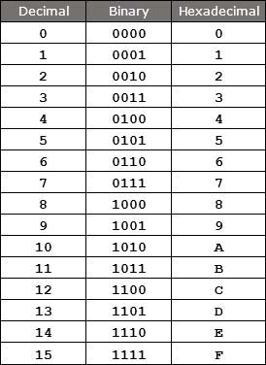
COMPUTER NETWORKS
Introduction to IPv6
128 bits address
340 undecillion address (340 + 33 digits)
IPv6 address apace is 2⁹⁶ times of the IPv4 address.
Made up of eight 16-bit blocks (octet)
Separated by ‘:’
Hexadecimal, each hexadecimal character – 4 bits
Rules:
Discard leading Zero(es)
If two of more blocks contain consecutive zeroes, omit them all and replace with double colon sign ::
340,282,366,920,938,463,374,607,431,768,211,456

Slide 72
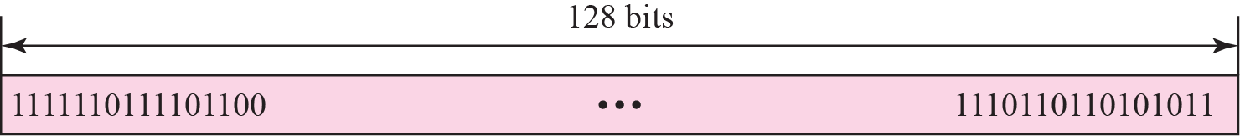
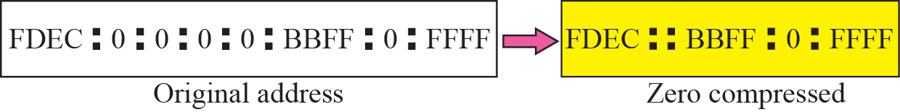
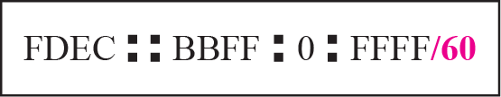
COMPUTER NETWORKS
Introduction to IPv6
Colon hexadecimal notation
Zero compression
CIDR address
Rule 1
Rule 2

Slide 73
COMPUTER NETWORKS
IPv6 Addressing
Show the unabbreviated colon hex notation for the following IPv6 addresses:
a. An address with 64 0s followed by 64 1s.
b. An address with 128 0s.
c. An address with 128 1s.
d. An address with 128 alternative 1s and 0s.
Solution
a. 0000:0000:0000:0000:FFFF:FFFF:FFFF:FFFF
b. 0000:0000:0000:0000:0000:0000:0000:0000
c. FFFF:FFFF:FFFF:FFFF:FFFF:FFFF:FFFF:FFFF
d. AAAA:AAAA:AAAA:AAAA:AAAA:AAAA:AAAA:AAAA

Slide 74
COMPUTER NETWORKS
IPv6 Addressing
The following shows the zero contraction version of addresses in previous example.
a. :: FFFF:FFFF:FFFF:FFFF
b. ::
c. FFFF:FFFF:FFFF:FFFF:FFFF:FFFF:FFFF:FFFF
d. AAAA:AAAA:AAAA:AAAA:AAAA:AAAA:AAAA:AAAA

Slide 75
COMPUTER NETWORKS
IPv6 Addressing
Show abbreviations for the following addresses:
a. 0000:0000:FFFF:0000:0000:0000:0000:0000
b. 1234:2346:0000:0000:0000:0000:0000:1111
c. 0000:0001:0000:0000:0000:0000:1200:1000
d. 0000:0000:0000:0000:0000:FFFF:24.123.12.6
Solution
a. 0:0:FFFF::
b. 1234:2346::1111
c. 0:1::1200:1000
d. ::FFFF:24.123.12.6

Slide 76
COMPUTER NETWORKS
IPv6 Addressing
Decompress the following addresses and show the complete unabbreviated IPv6 address:
a. 1111::2222
b. ::
c. 0:1::
d. AAAA:A:AA::1234
Solution
a. 1111:0000:0000:0000:0000:0000:0000:2222
b. 0000:0000:0000:0000:0000:0000:0000:0000
c. 0000:0001:0000:0000:0000:0000:0000:0000
d. AAAA:000A:00AA:0000:0000:0000:0000:1234

Slide 77
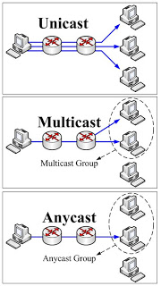
COMPUTER NETWORKS
Three Address Types
In IPv6, a destination address belong to:
  Unicast Address (one-to-one) – defines a single interface (computer or router)
  Multicast Address (one-to-many) – also defines a group of computers, each member of the group receives a copy.
  Anycast Address (one-to-nearest) – defines a group of computers that all share a single address.
  Broadcast Address (one-to-all) – ×

Slide 78
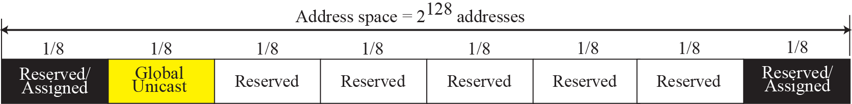
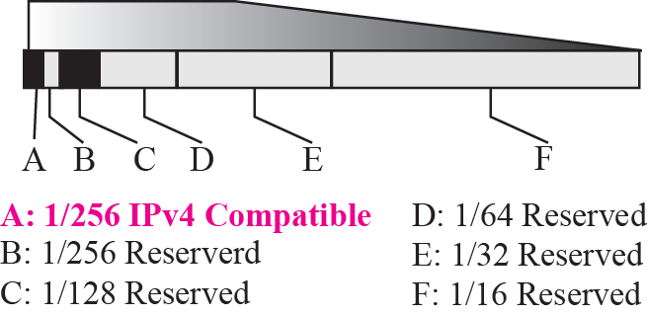
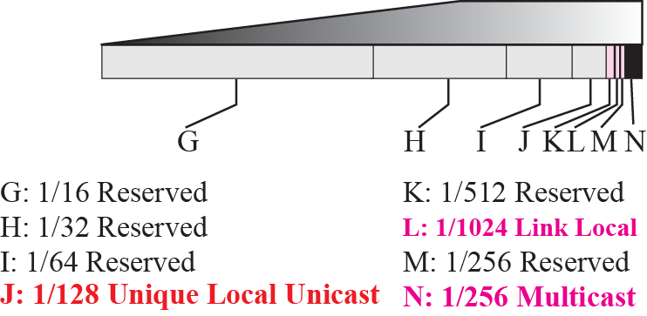
COMPUTER NETWORKS
Address Space Allocation

Slide 79
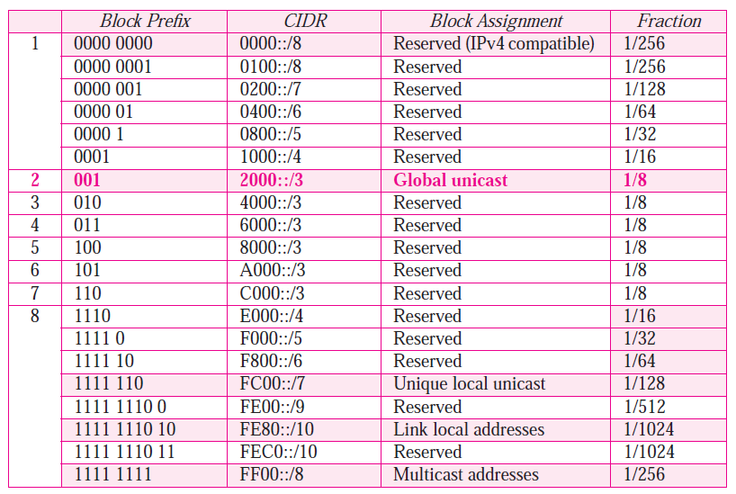
COMPUTER NETWORKS
Address Space Allocation
Figure shows that only a portion of the address space can be used for global unicast communication.
How many addresses are in this block?
Solution
This block occupies only one-eighth of the address spaces. To find the number of addresses, we can divide the total address space by 8 or 2³ . The result is (2¹²⁸)/(2³) = 2¹²⁵ —> a huge block.

Slide 80
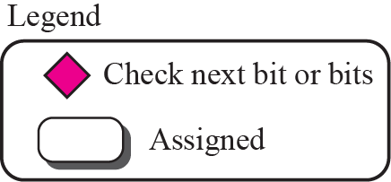

COMPUTER NETWORKS
Algorithm for finding the allocated blocks

Slide 81
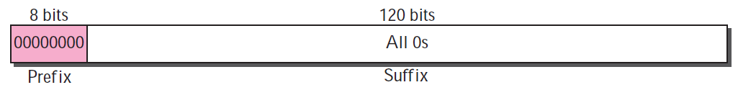
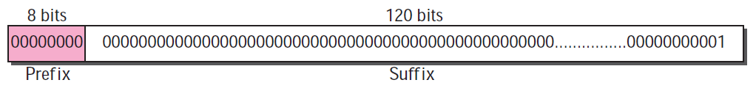
COMPUTER NETWORKS
Assigned and Reserved Blocks
The unspecified address in IPv6 is ::/128. It should never be used as a destination address.
The loopback address in IPv6 is ::1/128. It should never be used as a destination address.

Slide 82
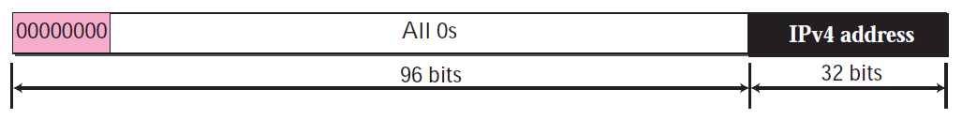
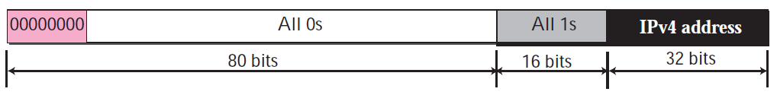
COMPUTER NETWORKS
Assigned and Reserved Blocks
Embedded IPv4 Addresses – Compatible Address.
CIDR notation is ::/96.
(Ipv6 -> IPv6)
Embedded IPv4 Addresses – Mapped Address.
(Ipv6 -> IPv4)

Slide 83
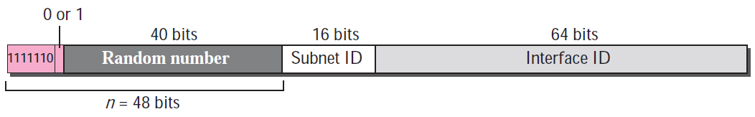
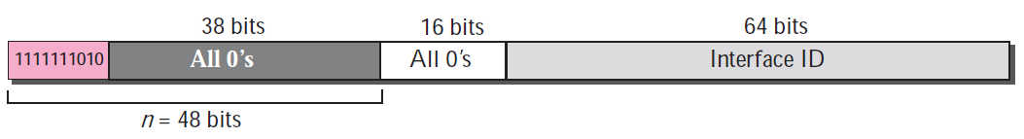
COMPUTER NETWORKS
Assigned and Reserved Blocks
Private Addressing in IPv6 – Site level & Link level
Unique local unicast block
Link local block

Slide 84
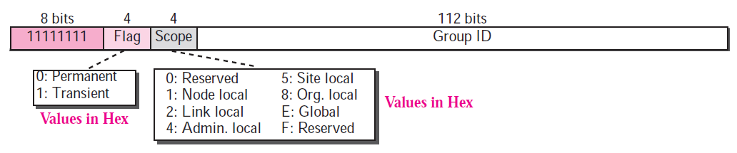
COMPUTER NETWORKS
Assigned and Reserved Blocks
Multicast address - used to define a group of hosts instead of just one.

Slide 85
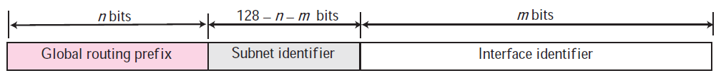
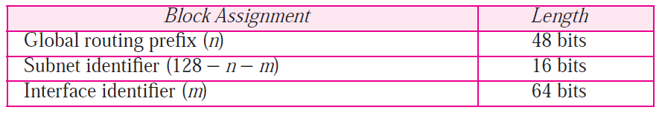
COMPUTER NETWORKS
Global Unicast Addresses
Used for unicast (one-to-one) communication between two hosts in the Internet.
CIDR notation for the block is 2000::/3 - three leftmost bits are the same for all addresses (001).
Three Levels of Hierarchy:
  Global Routing Prefix
  Subnet identifier
  Interface identifier
Global unicast address
Recommended Length of Different Parts in Unicast Addressing

Slide 86
COMPUTER NETWORKS
Global Unicast Addresses
  Global Routing Prefix –> 3 bits (001) + 45 bits = 2⁴⁵ sites (ISP/private org)
  Subnet identifier –> 2¹⁶ = 6553 subnets
  Interface identifier –> similar to Host ID in IPv4 (IP level & physical level are different),
    Physical address is 48 bits while the hostid is less than 32 bits
    Embed physical address (<64 bits) into Interface ID – whole/part
    Two physical addressing scheme :
      64-bit extended unique identifier (EUI-64) defined by IEEE &
      48-bit physical address defined by Ethernet.

Slide 87
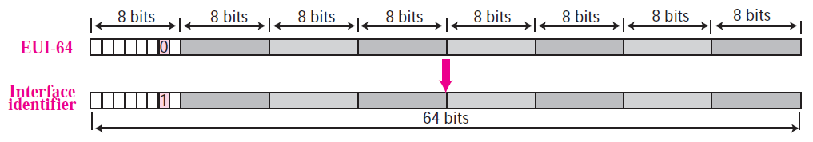
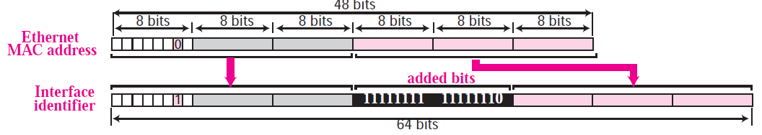
COMPUTER NETWORKS
Global Unicast Addresses
Mapping for EUI-64
Mapping for Ethernet MAC (48 bits)

Slide 88
COMPUTER NETWORKS
Global Unicast Addresses
Find the interface identifier if the physical address in the EUI is
(F5-A9-23-EF-07-14-7A-D2)₁₆ using the format we defined for Ethernet addresses.
Solution
We only need to change the seventh bit of the first octet from 0 to 1 and change the format to colon hex notation.
The result is F7A9:23EF:0714:7AD2.
2. Find the interface identifier if the Ethernet physical address is
(F5-A9-23-14-7A-D2)₁₆ using the format we defined for Ethernet addresses.
Solution
We only need to change the seventh bit of the first octet from 0 to 1, insert two octet FFFE16 and change the format to colon hex notation.
The result is F7A9:23FF:FE14:7AD2 in colon hex.

Slide 89
COMPUTER NETWORKS
Global Unicast Addresses
An organization is assigned the block 2000:1456:2474/48. What is the CIDR notation for the blocks in the first and second subnets in this organization?
Solution
Theoretically, the first and second subnets should use the block with subnet identifier 0001₁₆ and 0002₁₆. This means that the blocks are
2000:1456:2474:0000/64 and 2000:1456:2474:0001/64.
An organization is assigned the block 2000:1456:2474/48. What is the IPv6 address of an interface in the third subnet if the IEEE physical address of the computer is (F5-A9-23-14-7A-D2)₁₆?
Solution
The interface identifier is F7A9:23FF:FE14:7AD2. If we add this identifier to the global prefix and the subnet identifier, we get: 2000:1456:2474:0002:F7A9:23FF:FE14:7AD2/128

Slide 90
COMPUTER NETWORKS
Autoconfiguration
  In IPv6, a host can also configure itself (DHCP can still be used to allocate an IPv6 address to a host.)
    The host first creates a link local address for itself.
      10-bit link local prefix (1111 1110 10) + 54 zeros + 64-bit interface identifier.
    The host then tests to see if this link local address is unique.
      64-bit interface identifier is supposed to be unique (high probability)
      To confirm, sends a neighbor solicitation message, and waits for neighbor advertisement message. Fails -> DHCP.
    Pass -> host stores this address as its link-local address (for private communication), prepare its global unicast address.
      Sends a router solicitation message, receives a router advertisement message

Slide 91
COMPUTER NETWORKS
Global Unicast Addresses
Assume a host with Ethernet address (F5-A9-23-11-9B-E2)₁₆ has joined the network. What would be its global unicast address if the global unicast prefix of the organization is 3A21:1216:2165 and the subnet identifier is A245?
Solution
The host first creates its interface identifier as F7A9:23FF:FE11:9BE2
using the Ethernet address read from its card, the host then creates its link-local address as: FE80::F7A9:23FF:FE11:9BE2
Assuming that this address is unique, the host sends a router solicitation message and receives the router advertisement message that announces the combination of global unicast prefix and the subnet identifier as 3A21:1216:2165:A245:1232.
The host then appends its interface identifier to this prefix to find and store its global unicast address as: A21:1216:2165:A245:F7A9:23FF:FE11:9BE2

Slide 92
COMPUTER NETWORKS
Renumbering
  Renumbering of the address prefix (n) is built in IPv6 - to allow sites to change the service provider.
  Each site – prefix by service provider.
  If the site changes provider, address prefix need to be changed.
  Router – assign new prefix, use the existing prefix for a short time before disabling it (two prefixes – during transition time).
  Next Generation DNS – under study.

Slide 93
COMPUTER NETWORKS
Unit – 4 Network Layer and Internet Protocol
  4.1 Overview of Network Layer
  4.2 What’s Inside a Router?
  4.3 Switching
  4.4 The Internet Protocol (IP)
    Datagram format
    Fragmentation
    IPv4 addressing
    NAT
  4.5 Introduction to Network Layer Protocols
    DHCP
    ICMP
  4.6 IPv6 Addressing
  4.7 IPv6 Protocol
  4.8 Introduction to Routing Algorithms

Slide 94
COMPUTER NETWORKS
IPv6 Protocol: Rationale for Change
  Larger address space
  Better header format
  New options
  Allowance for extension
  Support for resource allocation
  Support for more security
checksum: removed entirely to reduce processing time at each hop
options: allowed, but outside of header, indicated by “Next Header” field
ICMPv6: new version of ICMP
fragmentation/reassembly: no

Slide 95
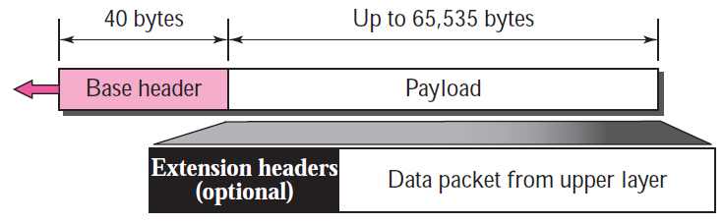
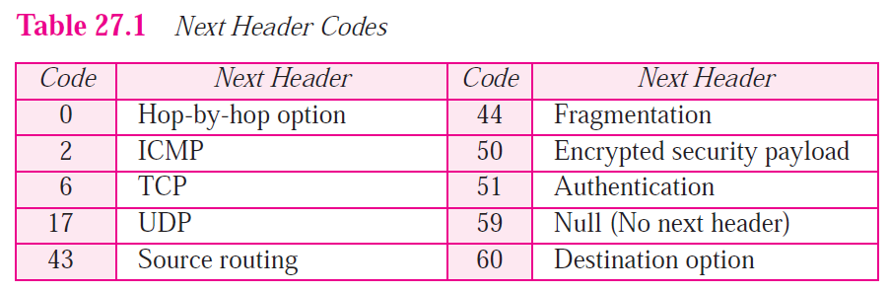
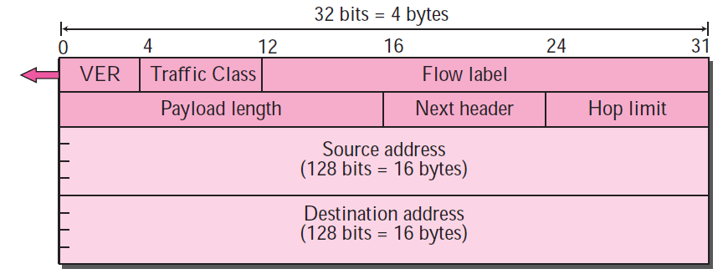
COMPUTER NETWORKS
IPv6 Datagram Format
Format of the base header

Slide 96
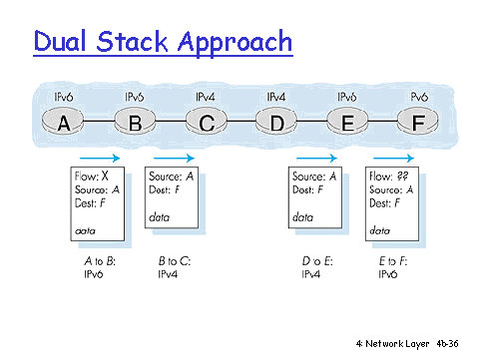
COMPUTER NETWORKS
Transition from IPv4 to IPv6
not all routers can be upgraded simultaneously
  no “flag days”
  how will network operate with mixed IPv4 and IPv6 routers?

Slide 97
COMPUTER NETWORKS
Transition from IPv4 to IPv6
not all routers can be upgraded simultaneously
  no “flag days”
  how will network operate with mixed IPv4 and IPv6 routers?
tunneling: IPv6 datagram carried as payload in IPv4 datagram among IPv4 routers (“packet within a packet”)
  tunneling used extensively in other contexts (4G/5G)
IPv4 header fields
IPv6 header fields
IPv4 payload
IPv4 source, dest addr
IPv6 source dest addr
UDP/TCP payload
IPv6 datagram
IPv4 datagram

Slide 98
COMPUTER NETWORKS
Tunneling and Encapsulation
Ethernet connecting two IPv6 routers:
A
B
Ethernet connects two IPv6 routers
E
F
IPv6
IPv6
IPv6
IPv6
IPv6 datagram
Link-layer frame
The usual: datagram as payload in link-layer frame
IPv4 network connecting two IPv6 routers
A
B
E
F
IPv6
IPv6/v4
IPv6/v4
IPv6
IPv4 network

Slide 99
COMPUTER NETWORKS
Tunneling and Encapsulation
Ethernet connecting two IPv6 routers:
A
B
Ethernet connects two IPv6 routers
E
F
IPv6
IPv6
IPv6
IPv6
IPv6 datagram
Link-layer frame
The usual: datagram as payload in link-layer frame
IPv4 tunnel connecting two IPv6 routers
A
B
IPv4 tunnel
connecting IPv6 routers
E
F
IPv6
IPv6/v4
IPv6/v4
IPv6
IPv6 datagram
IPv4 datagram
tunneling: IPv6 datagram as payload in a IPv4 datagram

Slide 100
COMPUTER NETWORKS
Tunneling
A
B
IPv4 tunnel
connecting IPv6 routers
E
F
logical view:
IPv6
IPv6/v4
IPv6/v4
IPv6
A
B
C
D
E
F
physical view:
IPv6
IPv6/v4
IPv4
IPv4
IPv6/v4
IPv6
flow: X
src: A
dest: F
data
src:B
dest: E
src:B
dest: E
src:B
dest: E
flow: X
src: A
dest: F
data
Flow: X
Src: A
Dest: F
data
Flow: X
Src: A
Dest: F
data
Flow: X
Src: A
Dest: F
data
Note source and destination addresses!
A-to-B:
IPv6
B-to-C:
IPv6 inside
IPv4
C-to-D
IPv6 inside
IPv4
D-to-E:
IPv6 inside
IPv4
E-to-F:
IPv6

Slide 101
COMPUTER NETWORKS
IPv6 Adoption
https://www.akamai.com/us/en/resources/our-thinking/state-of-the-internet-report/state-of-the-internet-ipv6-adoption-visualization.jsp

Slide 102
COMPUTER NETWORKS
Unit – 4 Network Layer and Internet Protocol
  4.1 Overview of Network Layer
  4.2 What’s Inside a Router?
  4.3 Switching
  4.4 The Internet Protocol (IP)
    Datagram format
    Fragmentation
    IPv4 addressing
    NAT
  4.5 Introduction to Network Layer Protocols
    DHCP
    ICMP
  4.6 IPv6 Addressing
  4.7 IPv6 Protocol
  4.8 Introduction to Routing Algorithms

Slide 103
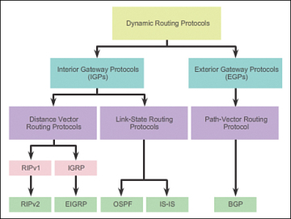
COMPUTER NETWORKS
Introduction to Routing Algorithms

Slide 104
COMPUTER NETWORKS
Distance Vector vs Link State
 | Distance Vector | Link State
Primary principle | Send entire routing table to its neighbors | Only provides link state information
Learning about network | Learn about network only from neighbors | Learn about network from all routers
Building the routing table | Based on inputs from only neighbors | Based on complete database collected from all routers
Advertisement of updates | Sends periodic updates every 30-90 seconds – Broadcasts updates | Use triggered updates, only when there is a change – Multicasts updates
Routing loops | Vulnerable | Less prone to routing loops

Slide 105
COMPUTER NETWORKS
Distance Vector vs Link State
 | Distance vector | Link State
Convergence (stabilization) | Slow | Fast
Resources | Less CPU power and memory | More CPU power and memory required
Cost |  | More than Distance vector
Scalability |  | More scalable than distance vector
Examples | RIP, IGRP | OSPF, IS-IS

Slide 106
THANK YOU
Ashwini M Joshi
Department of Computer Science and Engineering
ashwinimjoshi@pes.edu

